Slide 1

Viruses that move around?
Yongsuk Kang, Clint Rogers, Allie Seaman, Zahra Hosseinian

Slide 2


Slide 3
Final Project Requirements
Geocoding – Spatial Visual maps
Machine Learning: Scikit-Learn?
Use of Python Pandas, Plotly

Slide 4
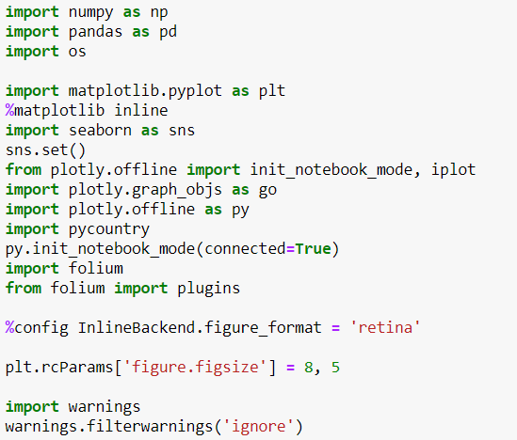
Libraries we imported for max tools:

Slide 5
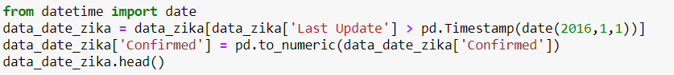
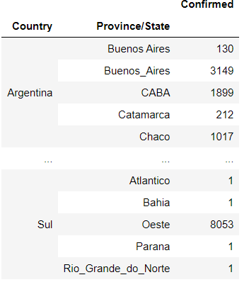
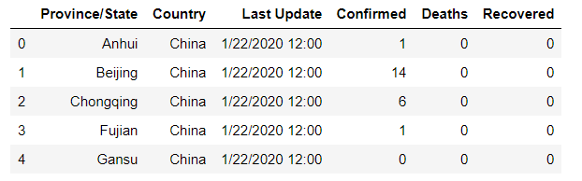
Cleaned up data and conformed our sets to fit a readable format for our project:

Slide 6
Geocoding the world

Slide 7
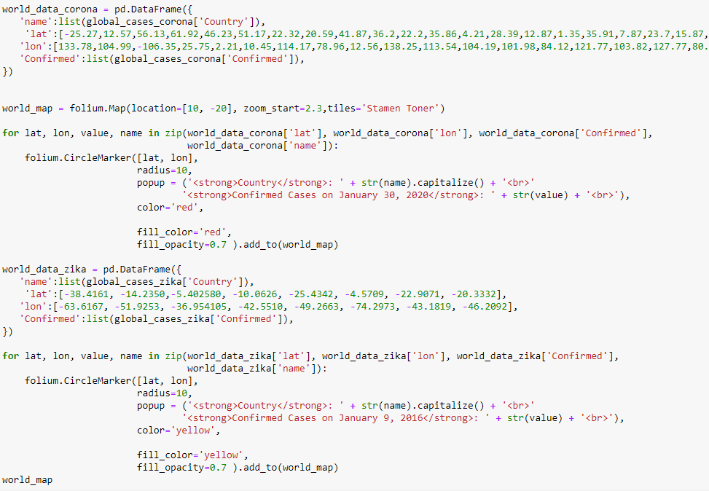

Slide 8
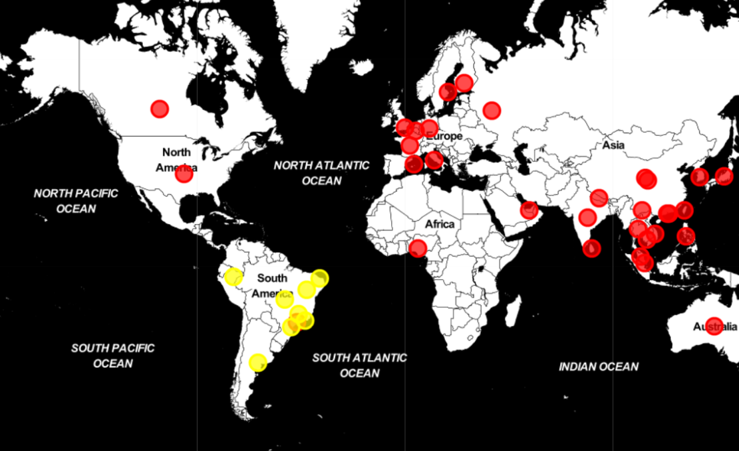

Slide 9
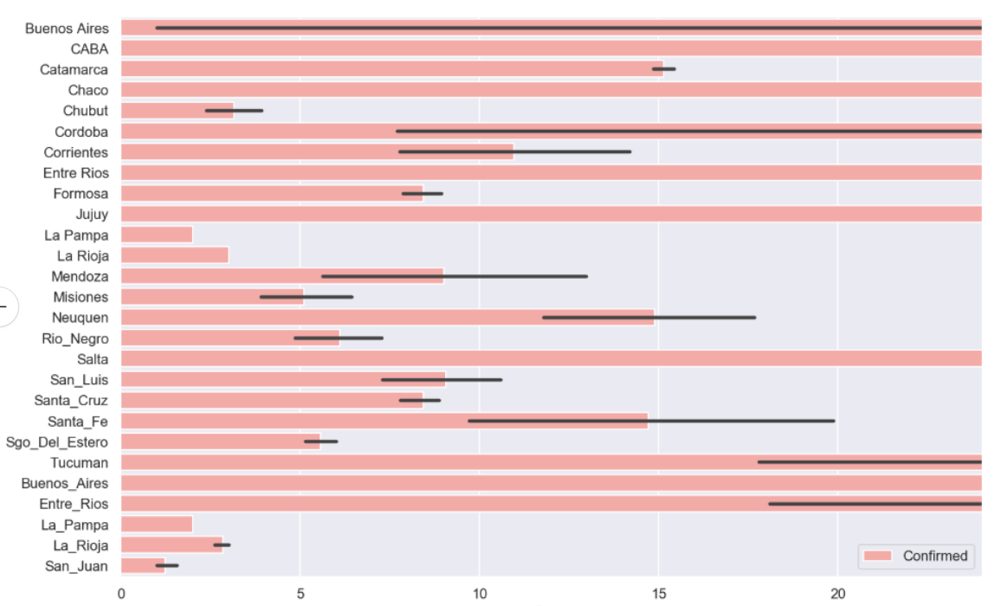
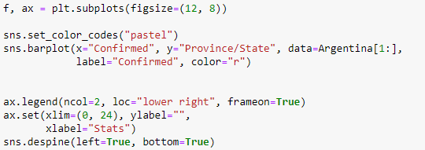
Zika Virus

Slide 10
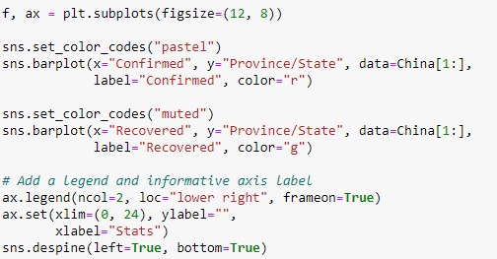
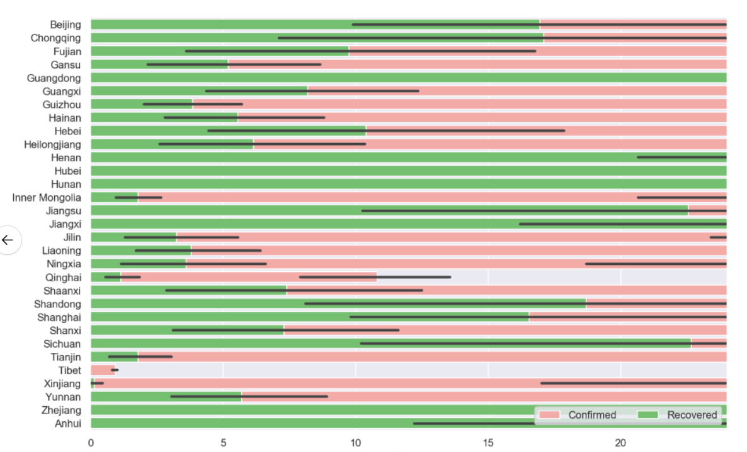
Corona Virus

Slide 11
Machine learning begins!

Slide 12
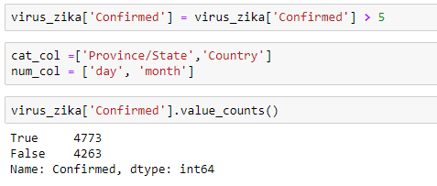
Used data from Zika dataset to train model and predict cases for the newly founded, and deadly, Corona virus
Data included: date, country, province/state and confirmed number of cases for both viruses
Extracted sources of data like day, month and converted them in to features
Imbued the missing data

Slide 13
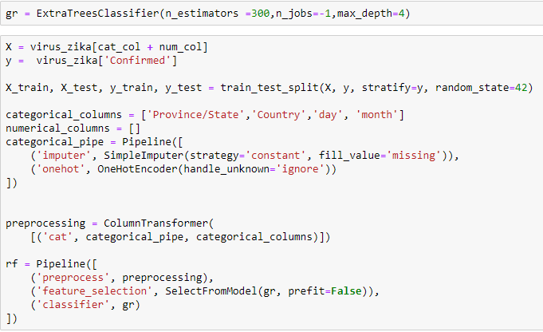
Used Machine Learning – PipeLine after trying various other machine learning techniques like NumericalPipe and CategoricalPipe

Slide 14
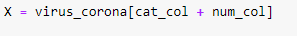
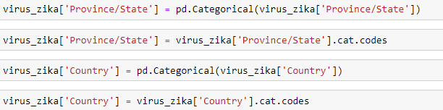
One-Hard-Encoded the features
Selected features using FeatureSelection
Fit the model
Maximum accuracy we obtained was 21%
Converting the data showed us that the model could not confirm number of cases
We tried multiple regression models before finding the one that was appropriate for our project: logistic regressions, gradient boosting regressions, and extratrees regressions
Gradient Boosting Regressions were the best model in our case
Converted the problem from regression to classifications to increase number to 88%

Slide 15
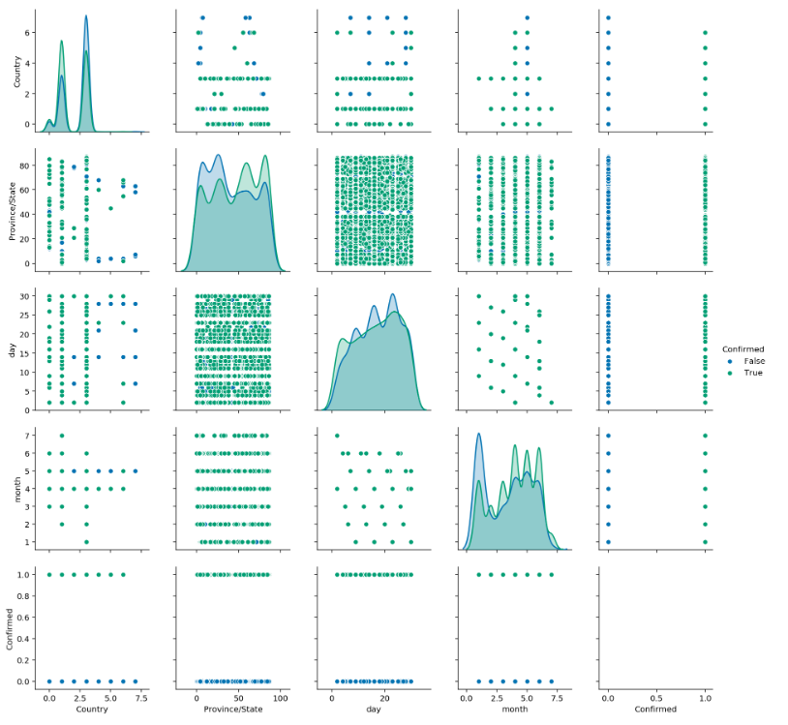

Slide 16
Take-Aways
Machine learning is more accurate when we classified items THEN performed regressions
Creating binary classes/grouping data could be helpful
Our data was leaking so we used all of the data to find optimal features. Since we used all of the data, the data from the training set leaked and showed results to be accurate when in fact they weren’t.
Classified <100 or >100, however we can classify it within 3 classes but we will use that as part of the next project, TBD.
There’s no association or correlation between the two viruses

Slide 17

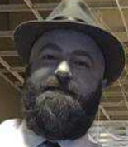
CONGRATULATIONS EVERYONE!!!!!
WE DID IT!!!!
Data Science Graduates 2020 – New Decade, New YOU 😐

